Slide 1
Dog intelligence
may predict
the size of a dog
Shraddha Swaroop, Emalina Huerta & Hilda Ulloa, STATS 510
Notes:
hilda

Slide 2
Background
Dog intelligence and size
Sample size = 124, based on different dog breeds
Data set tells us how long it takes dogs to learn commands
5 different classifications
brightest dogs, excellent working dogs, above average, average, fair
Dog’s Weight
Dog’s Height
Notes:
hilda

Slide 3
Research Questions
01
03
Our research
Height
02
Predictors
Does a dog’s obedience rate predict a dog’ height?
What are the strongest predictors in determining a dog’s height?
Weight
Is there a correlation between a dog's weight and height?
Notes:
hilda
Possible Question:
Does a dog’s obedience rate and the ability to respond to commands predict a dog’s height?
Original: Does a dog’s ability to respond to commands predict a dog’s height?
Original: Does a dog’s obedience rate and the ability to respond to commands predict a dog’s height?

Slide 4

Hypotheses
Height
01
There is a strong linear relationship between dogs’ obedience and height
02
Weight
There is a strong linear relationship between dogs’ weight and height
Predictors
03
The strongest predictors
will include weight and obedience rate
Notes:
shraddha

Slide 5
Regression Method
Variable selection
01
We used Stepwise Regression process, Best Subset Regression, and Mallow’s CP
02
LINE criteria
We analyzed each predictor and outcome variable to meet linearity, normality, and equal variances criteria
Regression Analysis
03
Then we ran a regression
analysis
Notes:
shraddha

Slide 6
Regression Method
Variable Selection
Response: Height
Predictor: average weight, lower repetitions, upper repetitions
y = average height
x1 = reps lower
x2 = reps upper
x3 = obey
x4 = weight high (lbs)
x5 = weight low (lbs)
x6 = average weight
Model 5: y = x1+ x2 +x3 +x4 +x5
Notes:
shraddha

Slide 7
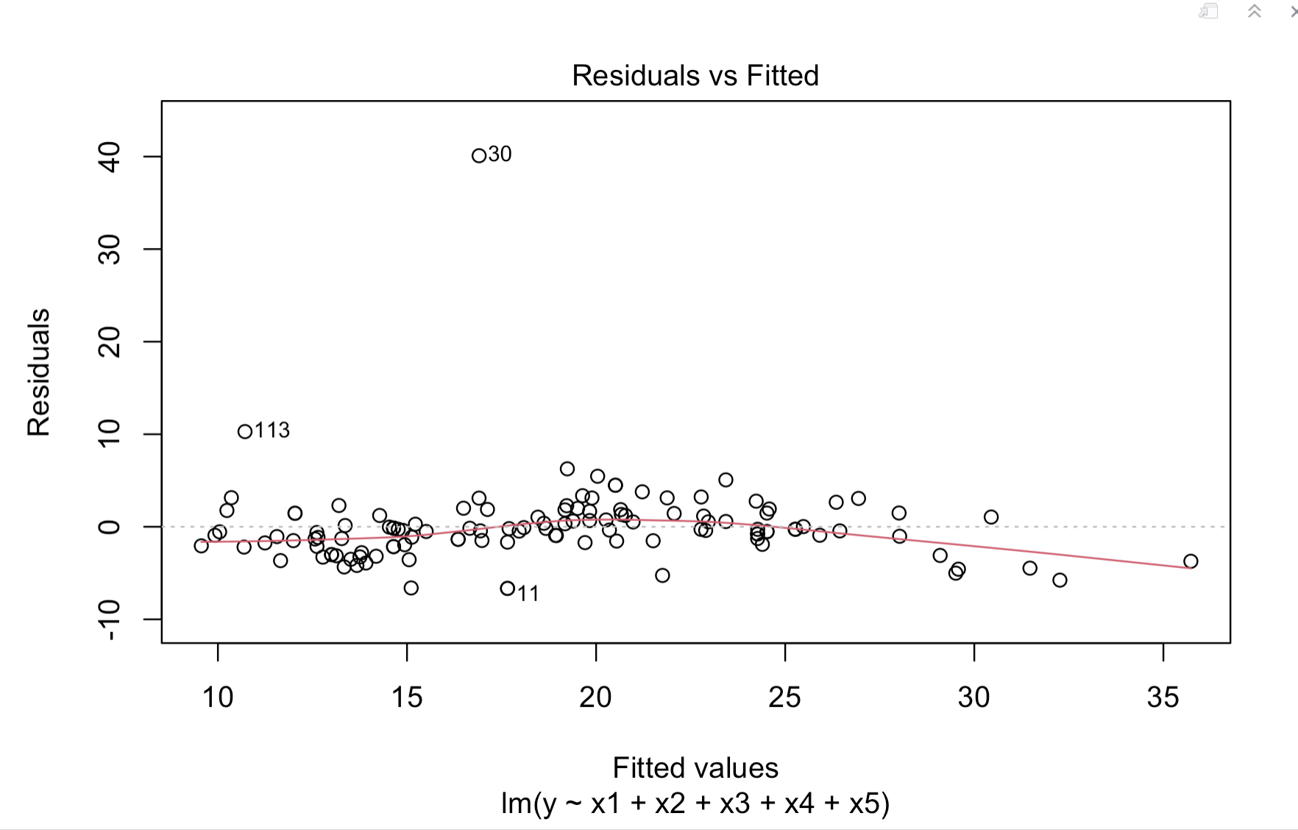

Linearity and equal variances assumption
Assumptions met
This plot shows most residuals along the zero-line with one outlier
y = average height
x1 = reps lower
x2 = reps upper
x3 = obey
x4 = weight high (lbs)
x5 = weight low (lbs)
Notes:
ema

Slide 8
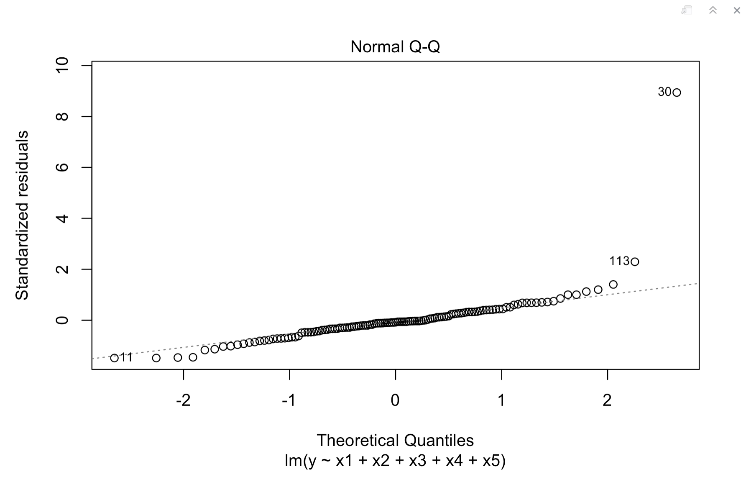
Normality
Assumptions met
The QQ Plot shows normality is met except for the outlier.
The Shapiro-Wilks test also showed normality with a p-value of 2.457e-07 which is much smaller than the alpha of .05
Notes:
ema

Slide 9
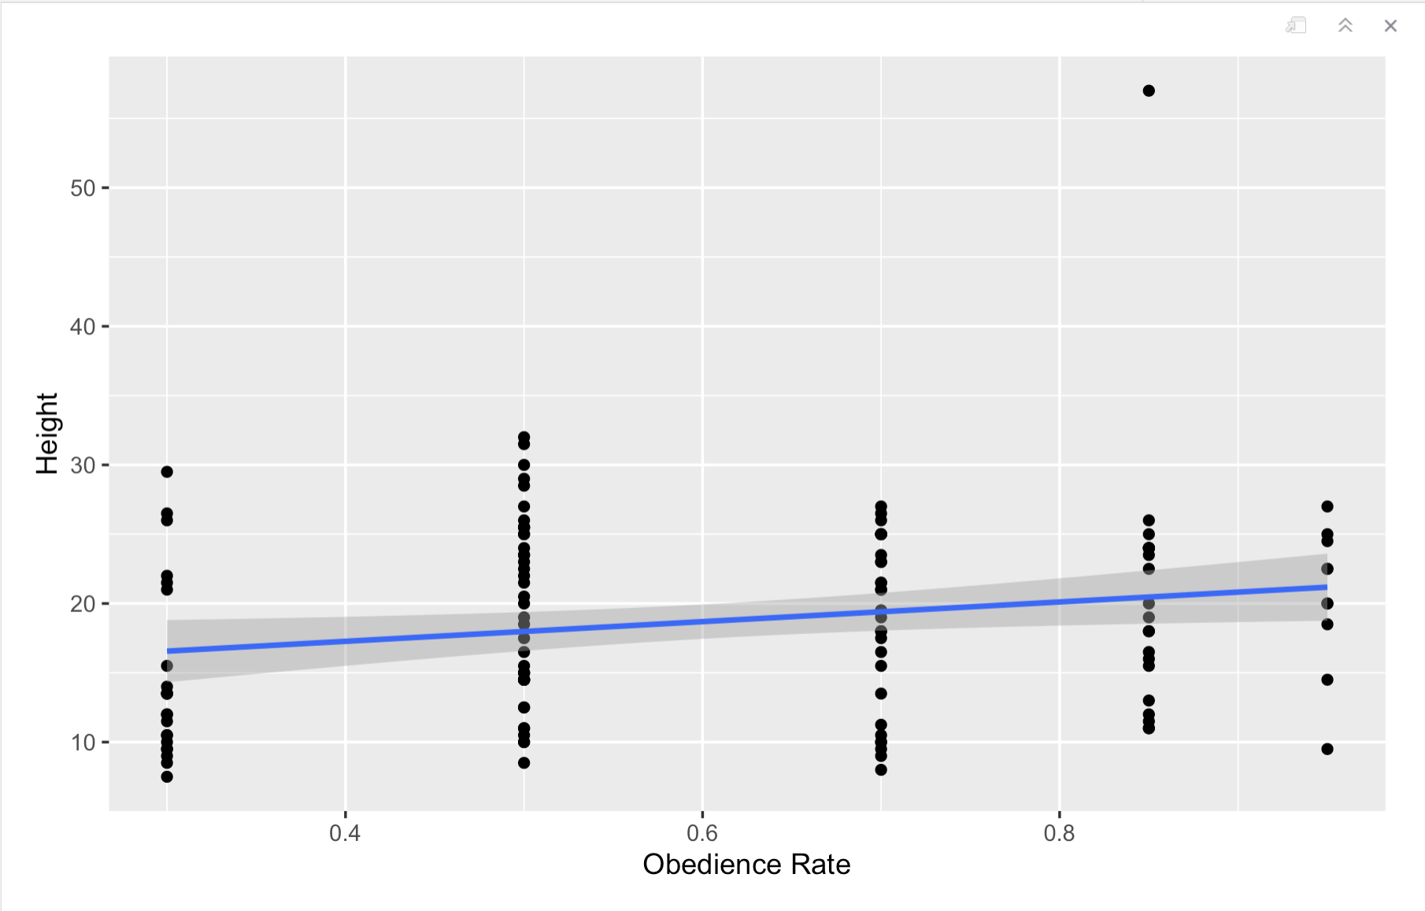
Results Q1: Obedience predicts dog height
There is a positive linear relationship between height and obedience rate. However, the relationship is not significant: The p-value is larger than the alpha of .05 There is sufficient evidence (F = 2.809, p − value = 0.08768) to conclude that the obedience rate and high level of commands are not significantly related to predicted height of a dog. The null hypothesis will fail to be rejected.
Avg Height Mean: 18.65 Avg Obedience Mean: 20.71
Confidence interval [ -30.15, 10.55 ]
Notes:
shraddha

Slide 10
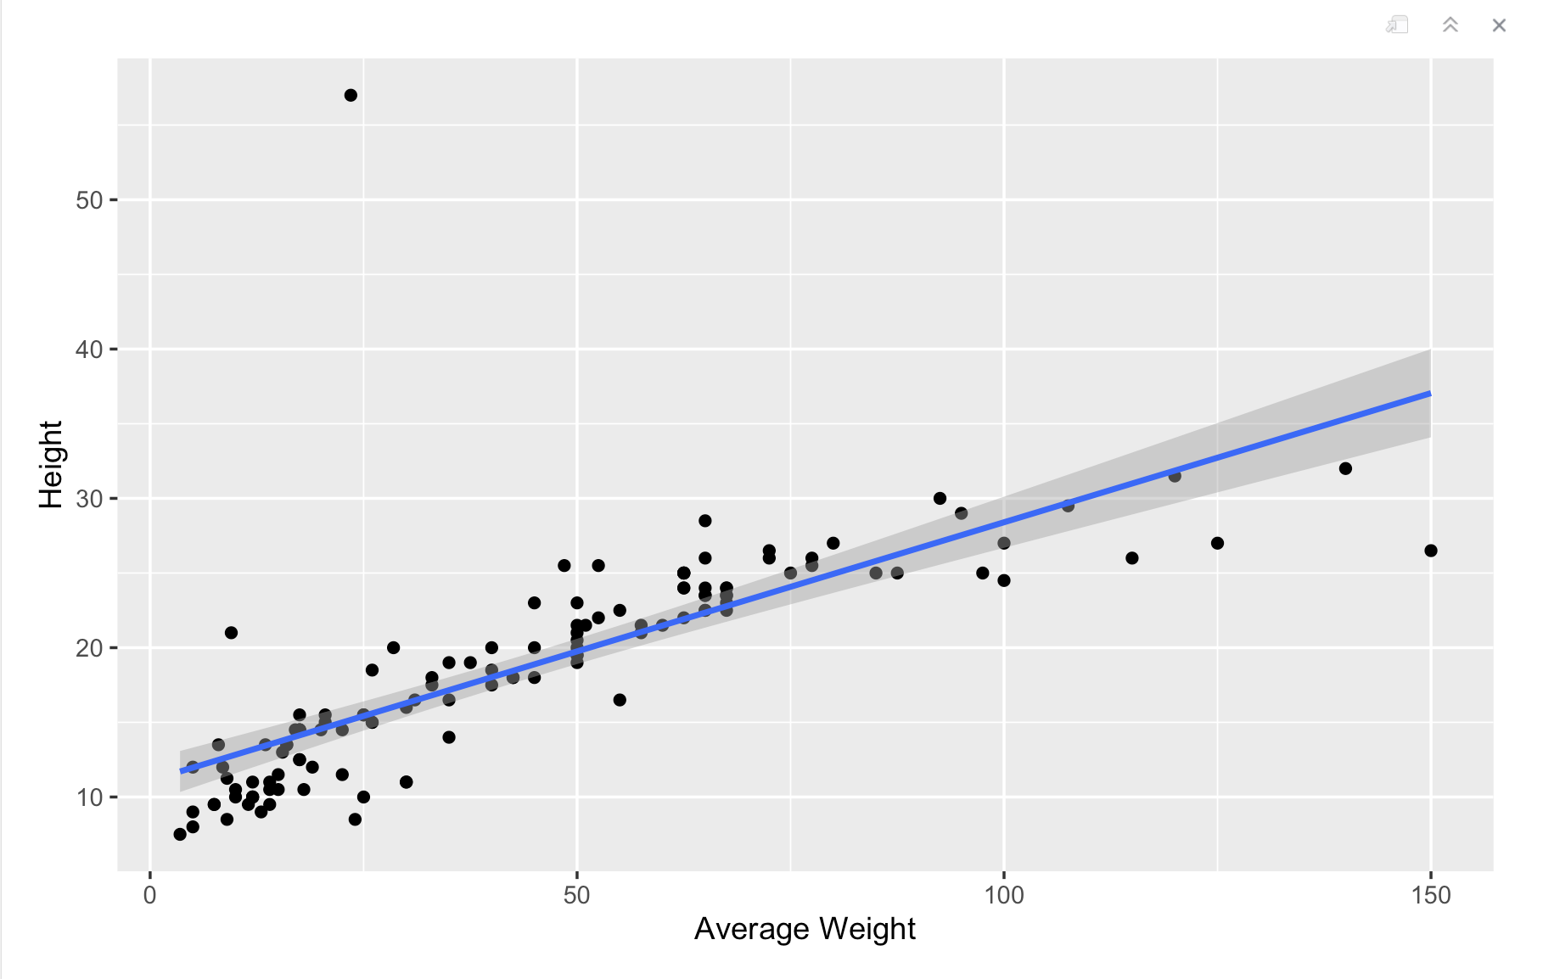
Results Q2
There is a relationship between weight and height of a dog
Positive Linear Relationship
Notes:
hilda

Slide 11
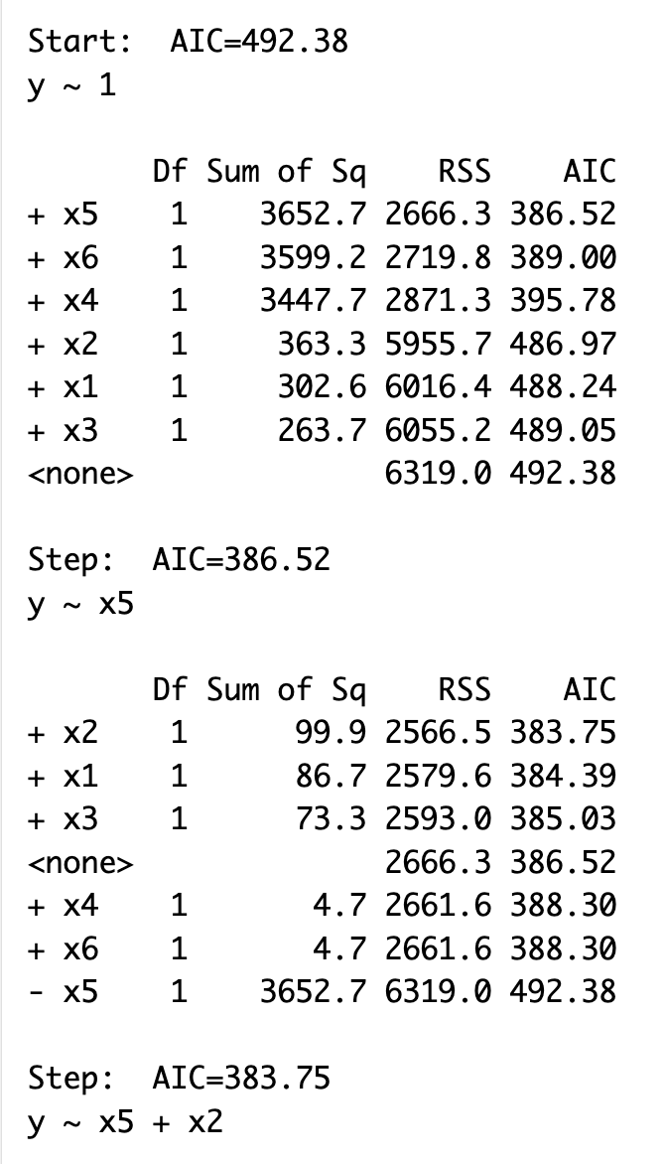
Results: Q3
What are the strongest predictors in determining a dog’s height?
AIC - Stepwise
X2 & x5
Subset Regression Process CP Mallows statistic
Model 5: y = x1+ x2 +x3 +x4 +x5
Notes:
ema

Slide 12
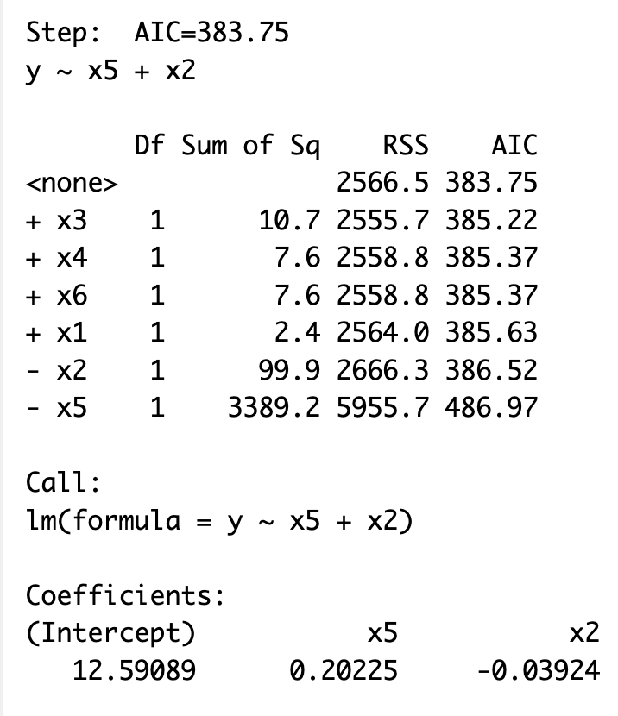
Results: Q3
What are the strongest predictors in determining a dog’s height?
AIC - Stepwise
X2 & x5
Subset Regression Process CP Mallows statistic
Model 5 was the most unbiased y = x1+ x2 +x3 +x4 +x5
Notes:
ema

Slide 13

Interpretation
Height
01
Height = 34.13 - 0.16(obedience) – 12.79(commands)
The overall regression was not statistically significant (R2 = 0.07, F(1, 122) = 2.96, p = < .08768)
(β = -.16, p = .0855)
95% confident that the mean number of commands dogs mastered is between 10.55 and -30.15, regardless of the obedience rate
02
Weight
Height = 11.10 +0.17(average weight)
The overall regression was statistically significant
(R2 = 0.57, F(1, 123) = 162.77, p = < 2.2e-16)
(β = 0.17, p = .2e-16)
95% confident that the mean weight of dogs increases by between .1461 and .1998 lbs
03
Predictors
Discussion of barriers in knowledge in working with categorical Y variable
Notes:
shraddha height, hilda weight, ema predictors

Slide 14


Conclusion
Intelligence has a positive linear relationship to height but there are other factors to consider:
Trainer
Gender
Heritage
Height and weight relationship
Diet
Notes:
hilda

Slide 15
References
Bray, E. E., Gruen, M. E., Gnanadesikan, G. E., Horschler, D. J., Levy, K. M., Kennedy, B. S., ... & MacLean, E. L. (2021). Dog cognitive development: a longitudinal study across the first 2 years of life. Animal cognition, 24(2), 311-328.
Carballo, F., Cavalli, C. M., Gácsi, M., Miklósi, Á., & Kubinyi, E. (2020). Assistance and therapy dogs are better problem solvers than both trained and untrained family dogs. Frontiers in Veterinary Science, 7, 164.
Duranton, C., Rödel, H. G., Bedossa, T., & Belkhir, S. (2015). Inverse sex effects on performance of domestic dogs (Canis familiaris) in a repeated problem-solving task. Journal of Comparative Psychology, 129(1), 84–87. https://doi.org/10.1037/a0037825
Marshall-Pescini, S., Valsecchi, P., Petak, I., Accorsi, P. A., & Previde, E. P. (2008). Does training make you smarter? The effects of training on dogs’ performance (Canis familiaris) in a problem solving task. Behavioural processes, 78(3), 449-454.

Slide 16
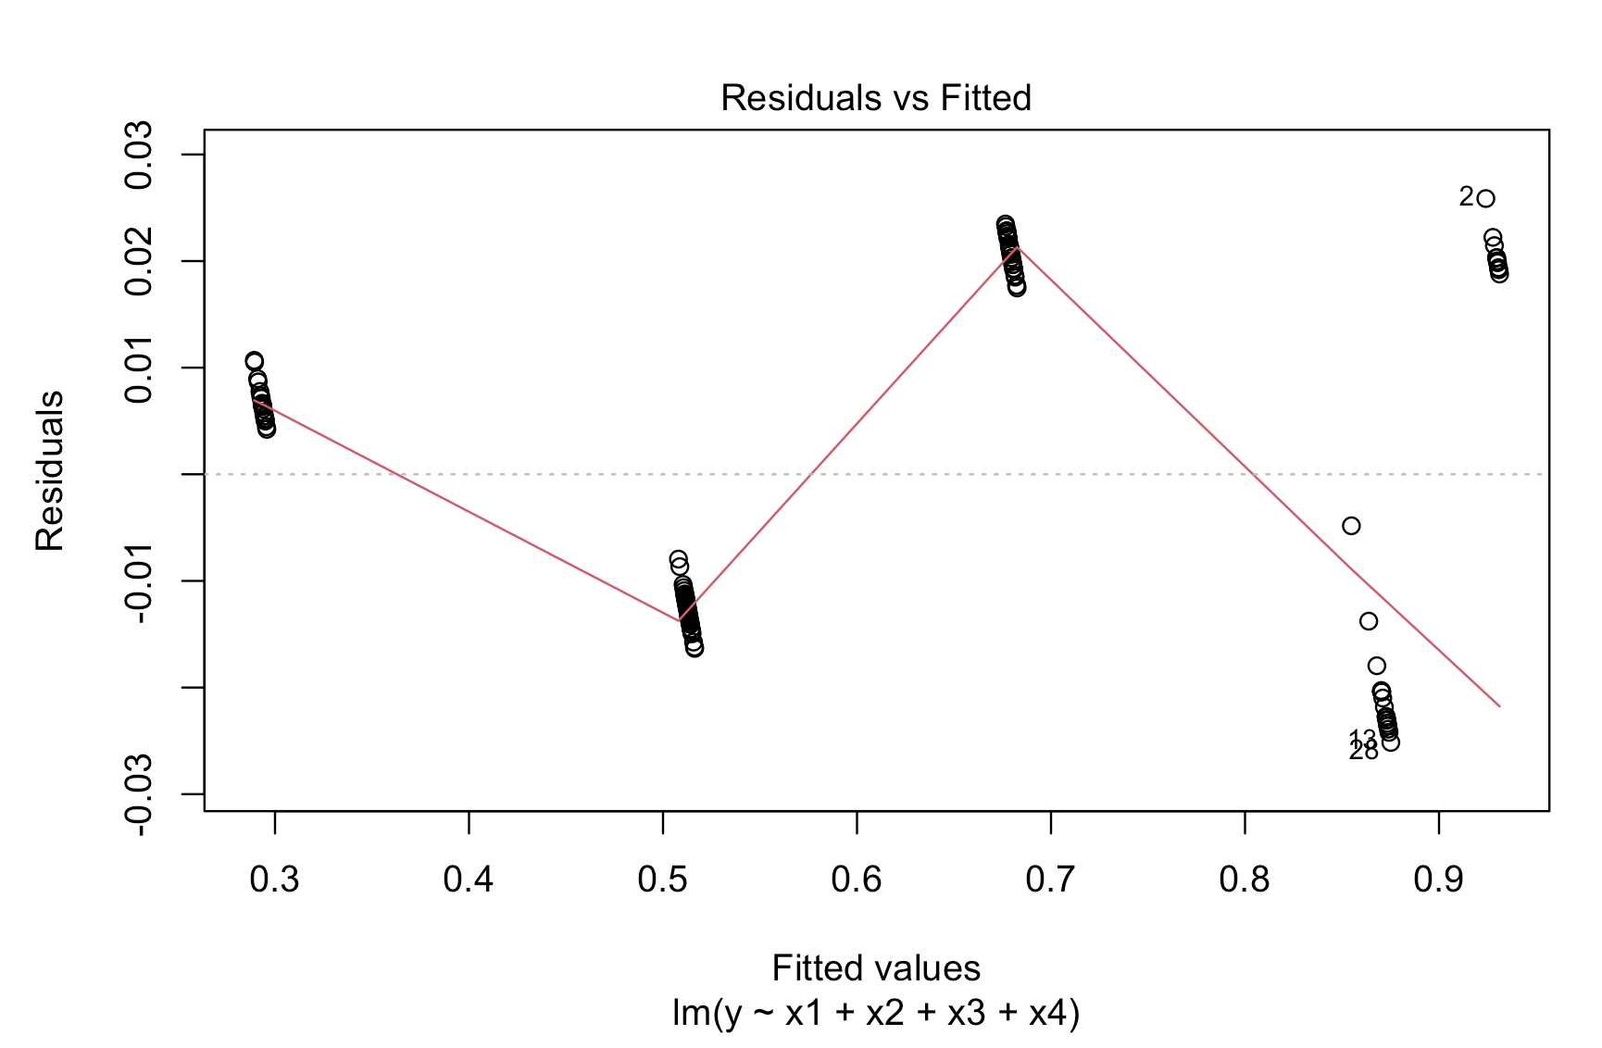
Appendix A: RvF plot with categorical outcome variable

Slide 17
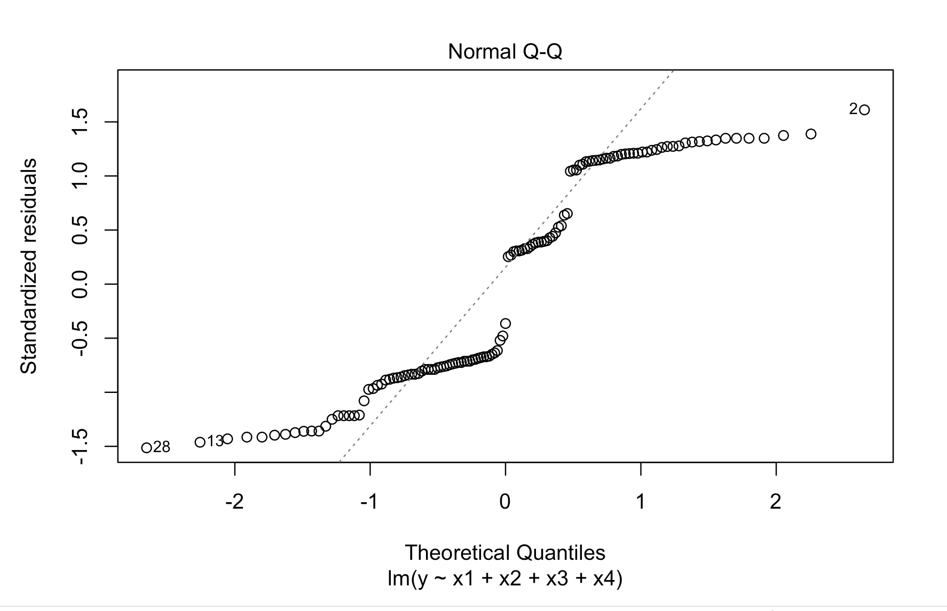
Appendix B: QQ-Plot with categorical outcome variable
Notes:
ema

